Slide 1
New to Game Development
Chas. Boyd
Principal Program Manager
Microsoft Corporation

Slide 2
Game Creation for the New Breed
This is a unique moment in the history of game development. Never before has it been so easy to create a new game, distribute it to 100s of millions of potential users, and get paid. Here is what you need to know to create an entertaining app for the Windows 8 marketplace, including the basics of planning, game design, development, and distribution.

Slide 3
Agenda
Preproduction = Market Analysis, Concept Development, Process Setup
The New Opportunity
Range of PCs
Market analysis, platform lifecycle, scale of opportunity
Concept Development
The Breadth of the Genre
Basics from Chris, 3 types, Be open minded, Be playful
visual style: limbo, braid, osmos, etc. Resurgence of innovation in gameplay, visuals, and the definitaoin of game itself
gameplay: osmos, minecraft, powdertoy, skywalk
The Game Development Process
prog, design, art, biz
Sources of Inspiration/Creativity
Demo scene, customer feedback, arcades
Resources
Gamasutra, Crawford, GDC, forums and blogs

Slide 4
Three Presentations Today
Step by Step through Game Development
How to set up the game <- You are here
How to code it
How to optimize it

Slide 5
The Game Development Process
Pre-Production
Customer Identification
Ideation/Creativity
Production
Game Design
Art
Coding
Biz

Slide 6
Me
Education: Aeronautical Engineering
Microsoft DirectX since DX3
Favorite Games:
Space War, Battlezone, Tailgunner,
Rogue, Gauntlet, Diablo
Original Doom, Heretic, Hexen,
Everquest, World of Warcraft,
Left 4 Dead

Slide 7
You
want to make money

Slide 8
Chapter 1/4
The Opportunity

Slide 9
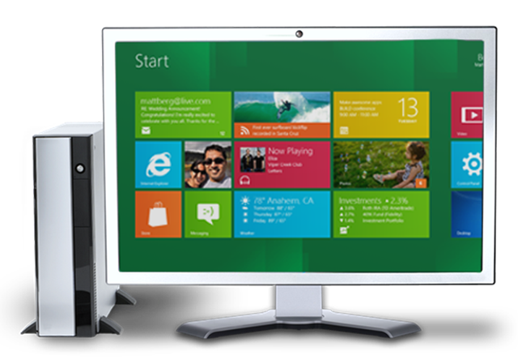
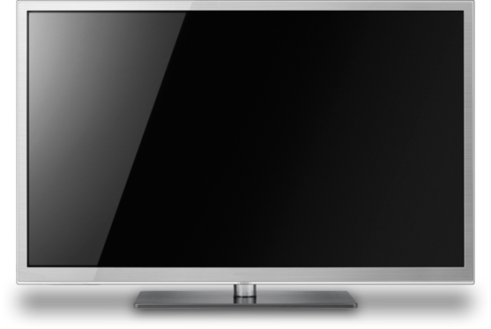

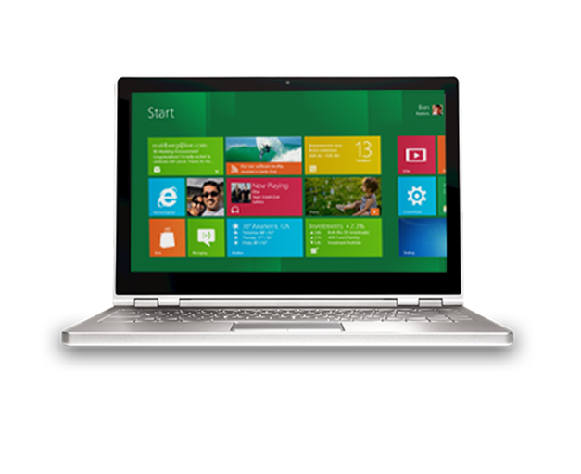
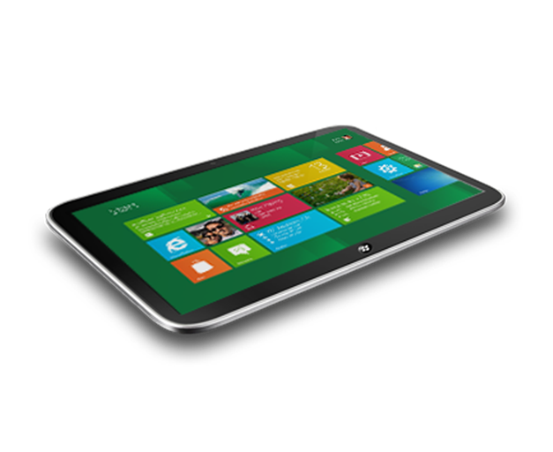
Windows
1,250,000,000
Windows PCs world-wide
525,000,000
Windows 7 PCs sold by Jan 1
400,000,000
new PCs to be sold in 2012
>500,000,000
estimated Windows 8-capable

Slide 10
Game Revenue
$70,000,000,000
game revenue
1,000,000,000
gamers
$21,600,000,000
mobile phone & tablet game revenue

Slide 11

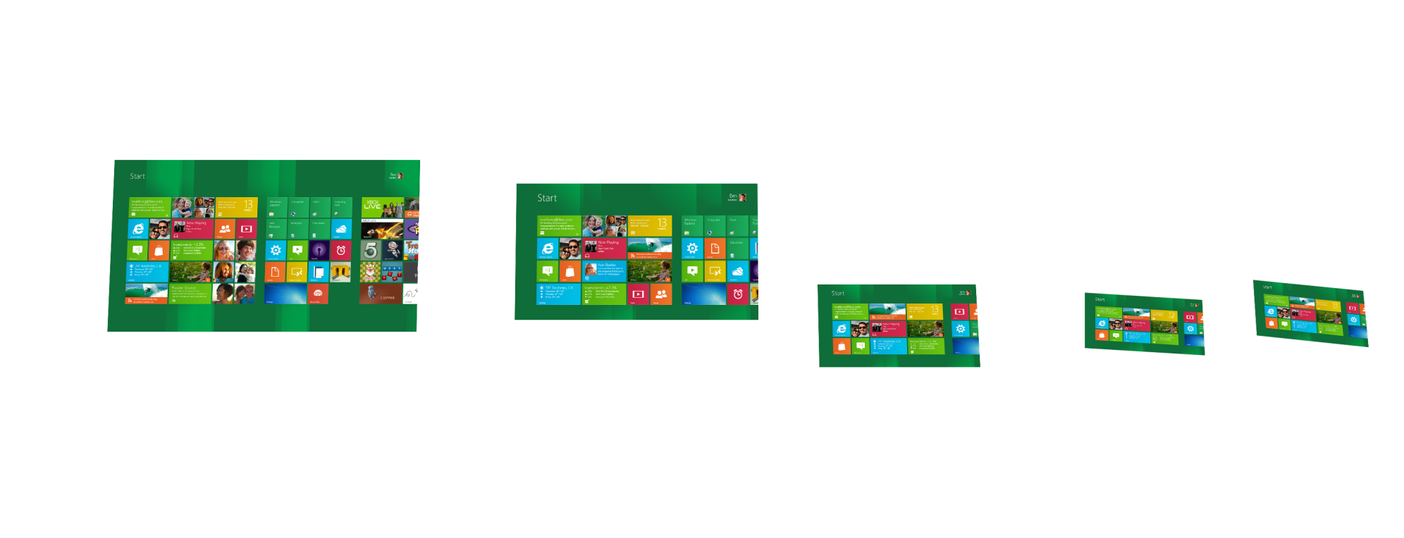
Windows 8 PC Spectrum

Slide 12
Varying Across the Spectrum
User situation
Session duration
Input methods
Network quality
Display size
Processor performance
Graphics feature level
RAM available
Size of app package

Slide 13
Constant Across the Spectrum
Processor core count
Display resolution (Pixel density)
Display quality and color range

Slide 14
The Gap:
There are very few titles that leverage the power of the PC in the situations of the tablet
20min playtime -couch (or commute)
Touch or accelerometer input
Multiplayer via WiFi
Photo-real graphics
1GB download

Slide 15
The Biggest Opportunity

Slide 16
Platforms have Cycles
Early Phase:
Immature tools, middleware infrastructure
Small installbase
Few participants
Mature Phase:
Stable Tools, rich middleware
Large installbase
Large field with dominant players

Slide 17
Platform Lifecycles
Metro-style apps constitute a new platform
It is going to be huge
Unless you are a household brand, visibility is critical
Get Out There Early

Slide 18
Market Data
Tons on the web:
NPD, Nielsen, Distimo, Flurry, etc.
Other Apps
Most stores make some info public
Valve Steam Survey
Skewing towards casual over time

Slide 19
Chapter 2/4
Concept Development

Slide 20
Title Categories
Toy
Puzzle
Game
Types of gameplay:
Play-through once vs Evergreen?
Extensible via add-ons?

Slide 21
Source Material
Gameplay Design:
Existing Toys, Puzzles, Arcade Games
Resources:
Gamasutra, GDC, Forums, Casual Connect,
Local groups,

Slide 22
Source Material
Art Design:
Demo Scene -pouet.net, scene.org
Photographs -definition of photoreal
Art Styles
Roman mosaics, pointillism, greek urns, heiroglyphics, oil paintings, wood cuts, shadow puppets, tissue paper cut-outs, blueprints, etc., etc.

Slide 23
Innovation
There is an opportunity to innovate like never before
Flexibility of the Hobbyist
+
Investment of the AAA shop
There is now a renaissance in game design

Slide 25
Exploit the limitations of the medium

Slide 26
Don’t over-reach
Start with a small project and iterate to improve
Store telemetry feedback can help

Slide 27
Think of a good name for your game

Slide 28
Chapter 3/4
Setting Up Shop

Slide 29
The Game Development Process
Pre Production
Customer Identification
Ideation/Creativity
Production
Game Design
Art
Coding
Biz

Slide 30
Game Design Role
Organize the results of that creativity in gameplay
Implement key algorithms, at least on paper, but ideally in some kind of code or script
Getting to operational is the first step
Use dummy objects, placeholder assets

Slide 31
Artist Role
Organize the results of that creativity in visual styles
Prototype visual effects for the key elements
Make sure you have the tools you need
Experiment to find easy ways to create the visuals
Write down the list of steps involved
They may form the seed of your art pipeline
Make sure visuals don’t get posted online without your approval

Slide 32
Software Dev Role
Set up the build machine(s)
Converge on the language to be used
Install the current dev bits
Get a codebase up and running
e.g. based on a sample app
To unblock gameplay development

Slide 33
Biz Role
Validate that the market exists
Make sure the planned monetization strategy is aligned with the expected use scenario
Sign up for the store
Sign up for facebook and twitter accounts
Look into a domain name and hosting
Look into becoming an LLC

Slide 34
Chapter 4/4
Business Details

Slide 35
Flexibility of Windows 8 Store Commerce
One-time purchase
In-App purchases & DLC
Time-limited trials
Persistent purchases
Feature-differentiated trials
Expiring purchases
Ad- supported
Use your existing commerce
Choice of ad services
Existing relationship
Subscriptions
Consumable purchases
Purchases roam across devices and CPU architectures

Slide 36
Some Monetization Facts
Trials matter
70× downloads
10× revenue
10% conversion
Source: The Windows Phone Developer blog, March 2011

Slide 37
More Monetization Facts
In-app offers matter
72% of revenue comes from apps that feature in-app offers
48% of revenue is solely from in-app offers
Source: Distimo, August 2011

Slide 38
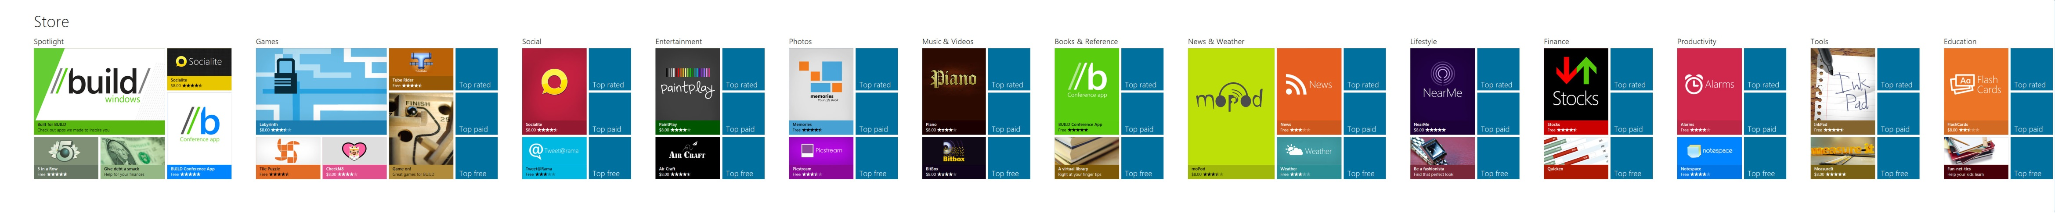
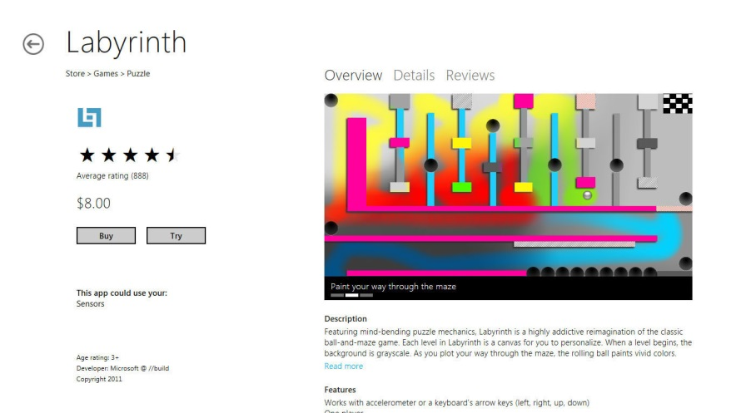
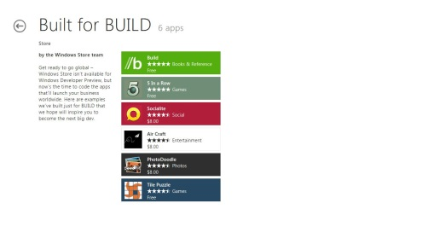
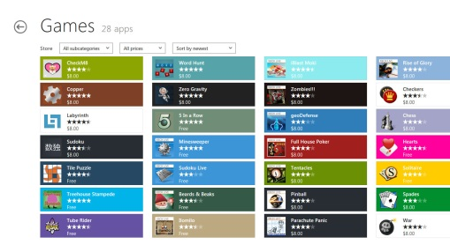

Discoverability on Windows Scale
App listing
Editorial promotion
Category
Metro IE Integration
Web Traffic (e.g., search, social)

Slide 39
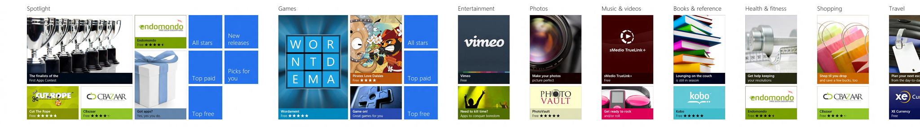
The Windows 8 Store
App listing
Editorial promotion
Category
Internet Explorer integration
Web traffic (for example: search & social)

Slide 40

Windows 8 Store: Global Reach & Transparency
Commerce in 200+ markets at launch
Store & apps in 100+ languages at launch
Local currencies in 70+ markets at launch
App submission in 40+ markets at launch
Many market-specific catalogs
Predictable
Concise
Clear
Safe
Fair

Slide 41
Best Economics
Revenue sharing for new app: 70% to start
Revenue sharing after app grosses $25K: 80%
You control the pricing of your app: $1.49 - $999.99

Slide 42
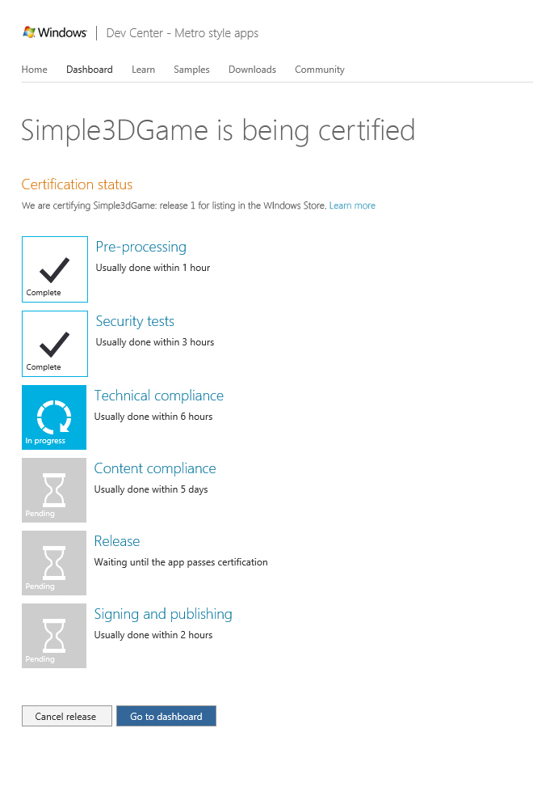
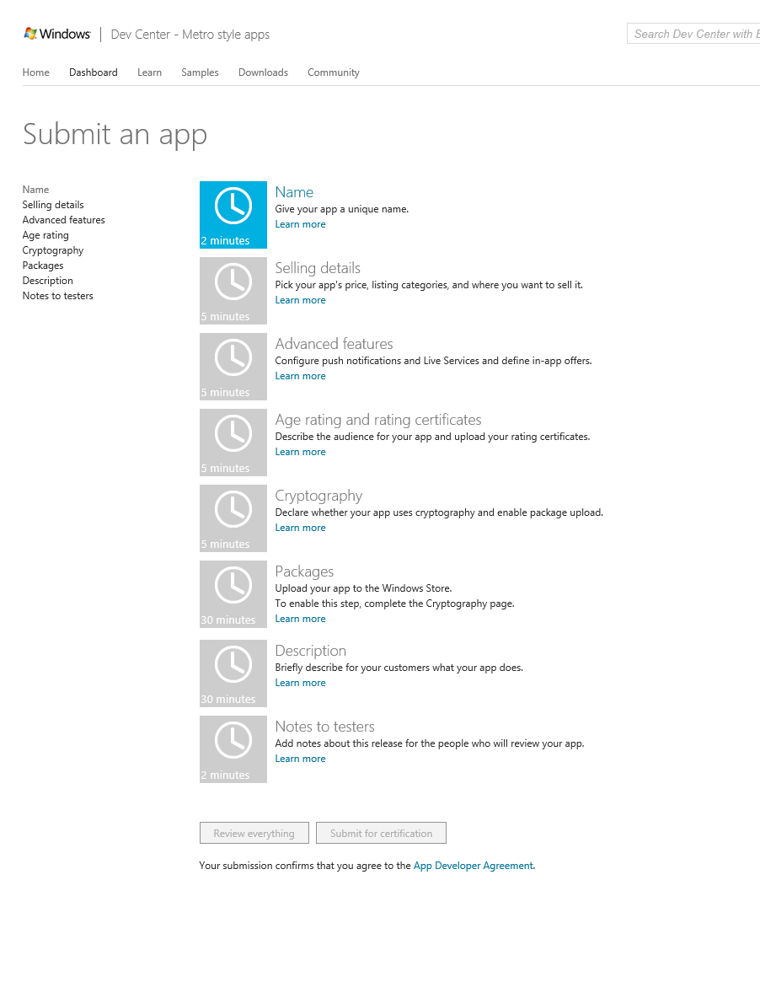
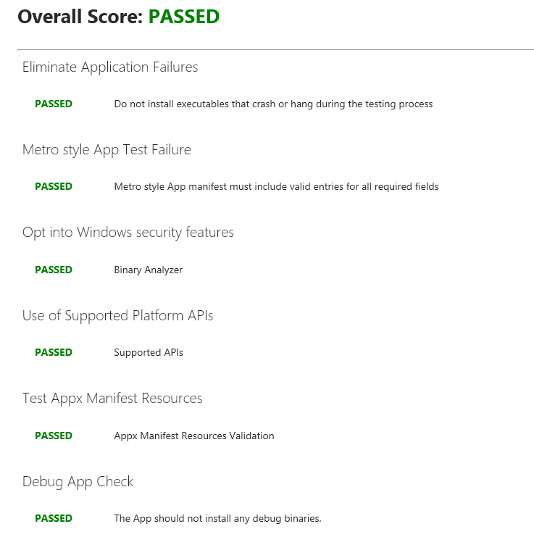
Certification and Onboarding

Slide 43
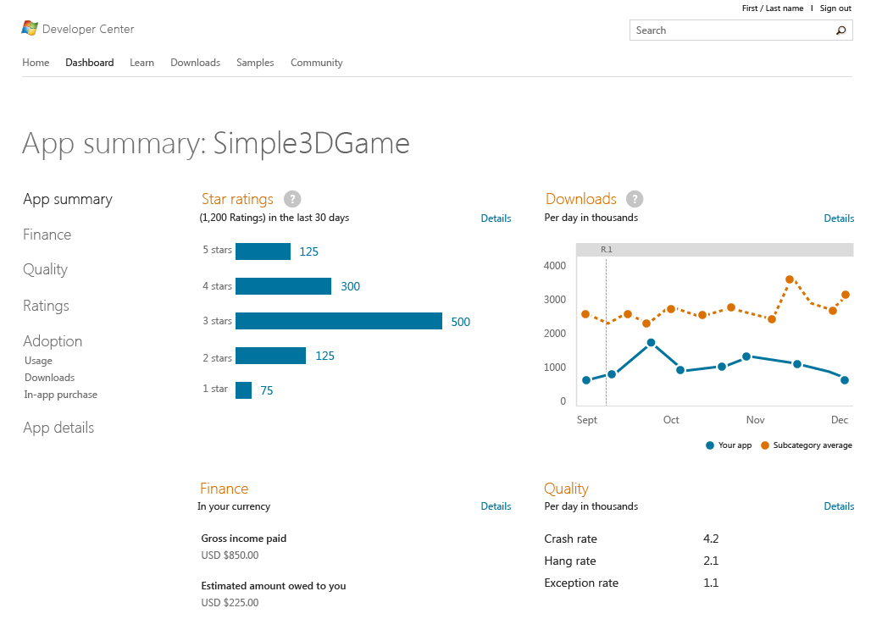

Slide 44
Monetization: Best Practices
One app for both trial and full functionality
Tell users about limitations of the trial
Register callback for license changes
Encourage additional purchases
Increase engagement = grow game value over time

Slide 45
Success Factors
A Great Concept
Innovative and appealing to the chosen audience
A Polished Implementation
Excellent user experience from discovery on
Good Visibility
Getting the word out via effective media
Appropriate Business Model
Pricing, trial vs in-app purchase vs DLC vs ad-based

Slide 46
Additional Resources
Keep an eye out for help:
Friends, relatives may have useful skills e.g. tester
Crowd-funding may be what you need
Kickstarter or similar sites

Slide 47
Time to Act
Biggest opportunity. Ever.
Windows 8 Consumer Preview is now available.
Check out the store.
Go build great games.
http://dev.windows.com

Slide 48
Q & A

Slide 49

© 2012 Microsoft Corporation. All rights reserved. Microsoft, Windows, Windows Vista and other product names are or may be registered trademarks and/or trademarks in the U.S. and/or other countries.
The information herein is for informational purposes only and represents the current view of Microsoft Corporation as of the date of this presentation. Because Microsoft must respond to changing market conditions, it should not be interpreted to be a commitment on the part of Microsoft, and Microsoft cannot guarantee the accuracy of any information provided after the date of this presentation. MICROSOFT MAKES NO WARRANTIES, EXPRESS, IMPLIED OR STATUTORY, AS TO THE INFORMATION IN THIS PRESENTATION.

Slide 50
Agenda
Introductions
The Breadth of the Genre
Development Process
The New Opportunity
Sources of Inspiration/Creativity
Demoscene, customer feedback, arcades
1 20’
Subtopic 1 5’
Subtopic Info

Slide 51
Chapter 1/4
General Guidelines

Slide 52
Q&A

Slide 53
Microsoft Colors
Choose 1 core color and up to 3 more secondary colors.
The core color should be used on the first walk-in slide.
RGB 0 0 166
RGB 0 113 188
RGB 0 174 239
RGB 0 166 0
RGB 140 198 0
RGB 255 242 0
RGB 255 190 0
RGB 255 138 0
RGB 255 83 0
RGB 255 0 0
RGB 255 0 151
RGB 145 0 145

Slide 54
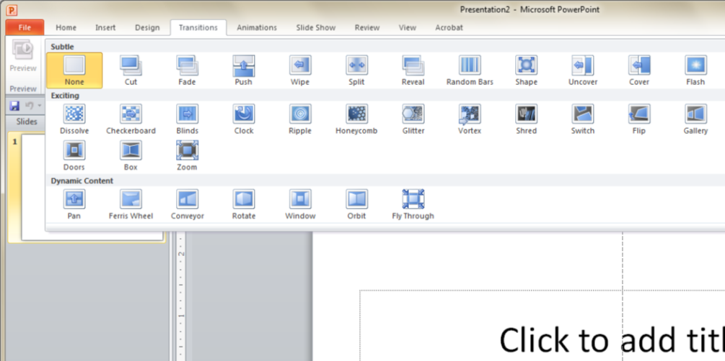
Choosing Slide Transitions
Limit the slide transitions to two types per deck.
Choose from these preferred settings.
Fade with 1 second duration
Reveal with 1.5 second duration
Push with 1.5 second duration, from right
Pan with 1.5 second duration, from right

Slide 55
Not all Slides need Tiles
Titles in Color, Segoe UI Light, 30pt
Main Content is in Dark Grey.
Use Segoe UI, 15pt.
Not all Slides need Tiles!
If you need Bullets, use Filled, Square in Text Color.
Use only if needed.
Titles are Level 1
Main Content is Level 2
Bullets are Level 3
9%
58%

Slide 56

Device Imagery
Hardware guidelines
Use the latest devices from current year’s release.
Screen captures should be up-to-date.
Remove OEM logos when possible
Drop shadows for devices only
Use drop shadows to provide subtle depth
Shadows shouldn’t exceed 30% opacity
Shadows shouldn't be less than 70 transparent

Slide 57
Chapter 2/4
Beautiful Imagery

Slide 58
Using Full Screen Images
Use Full Screen Images to Capture your Audience
Copy the gradient and caption text from this slide to your full screen image.
Your Caption Here

Slide 59

The Power of Images

Slide 60
Chapter 3/4
Using Tiles

Slide 61

Template: Metro Blocks
Plain Color Tiles
Use Text / White Icons
Picture Tiles
Replace any Plain Tiles you like with Images.
Use Text on a Shape with a Gradient if it benefits Readability.
Text/Icon/Image
Picture Caption
Text/Icon/Image
Text/Icon/Image
Picture Caption

Slide 62

Template: Metro Blocks
Metro Block Variations
See the Slide Master for all possible Metro Block Variations.
No Obligations
Only use the Metro Blocks if it makes sense for your slide.
Text/Icon/Image
Text/Icon/Image
Picture Caption

Slide 63
Chapter 4/4
Using Icons

Slide 64



Choosing the Right Icons
Guidelines for icons
Choose from existing brand icons
Use text within the tile for descriptions when necessary.
If you need new icons…
Remember to choose simple and minimal
Less unnecessary detail is better
Use metro/transit signage as a good example of style
Icons should only appear in white or black
Icon Caption
Icon Caption
Icon Caption
Icon Caption

Slide 65
Choosing the Right Icons (Animated)
Guidelines for icons
Choose from existing brand icons
Use text within the tile for descriptions when necessary.
If you need new icons…
Remember to choose simple and minimal
Less unnecessary detail is better
Use metro/transit signage as a good example of style
Icons should only appear in white or black
Icon Caption
Icon Caption
Icon Caption
Icon Caption

Slide 66
Game Development Process
Market Analysis
Choose from existing brand icons
Use text within the tile for descriptions when necessary.
Creativity/Prototyping
Remember to choose simple and minimal
Less unnecessary detail is better
Use metro/transit signage as a good example of style
Icons should only appear in white or black
Icon Caption
Icon Caption
Icon Caption
Icon Caption

Slide 67
© 2012 Microsoft Corporation. All rights reserved. Microsoft, Windows, Windows Vista and other product names are or may be registered trademarks and/or trademarks in the U.S. and/or other countries.
The information herein is for informational purposes only and represents the current view of Microsoft Corporation as of the date of this presentation. Because Microsoft must respond to changing market conditions, it should not be interpreted to be a commitment on the part of Microsoft, and Microsoft cannot guarantee the accuracy of any information provided after the date of this presentation. MICROSOFT MAKES NO WARRANTIES, EXPRESS, IMPLIED OR STATUTORY, AS TO THE INFORMATION IN THIS PRESENTATION.

